Slide 1
Recurrent Neural Network
Bakul Gohel, Ph.D.
DA-IICT, Gandhinagar

Slide 2
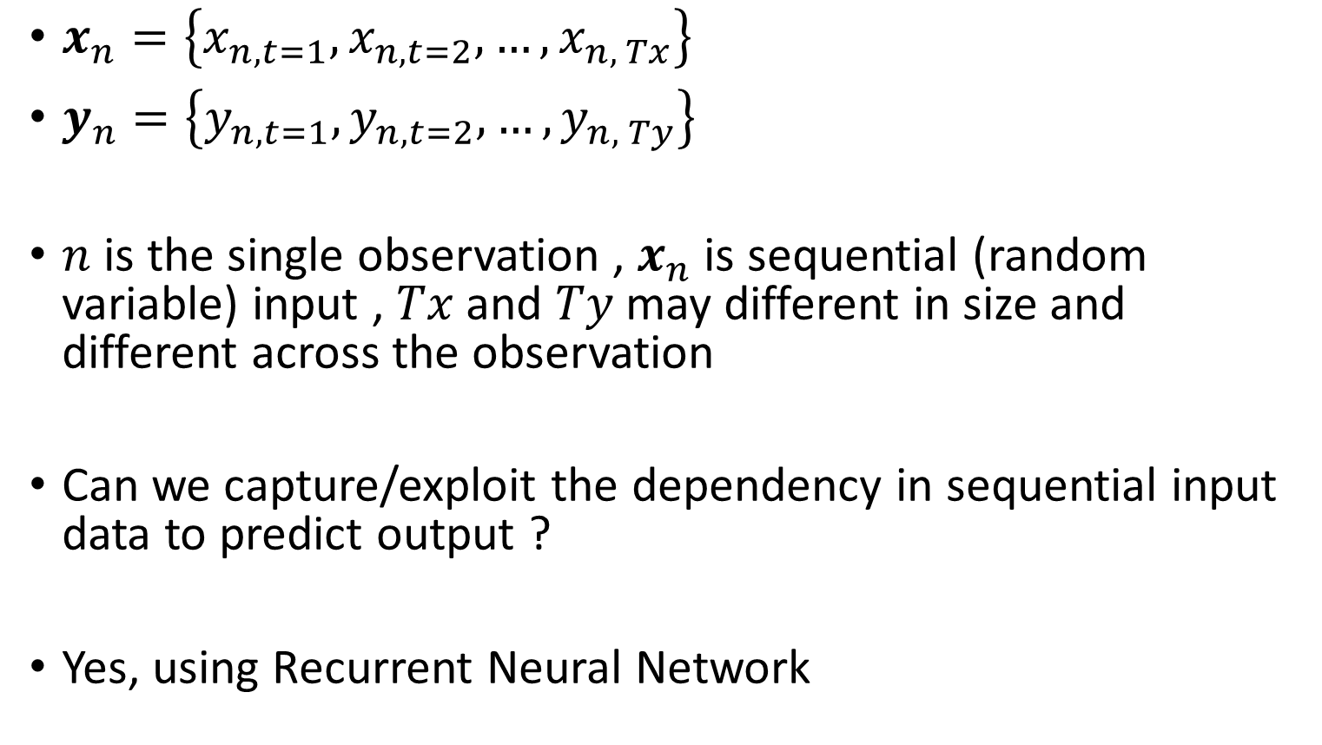
Sequential Input / Output
$x_{n}=\left\{x_{n,t=1},x_{n,t=2},…, x_{n, Tx}\right\}$
$y_{n}=\left\{y_{n,t=1},y_{n,t=2},…, y_{n, Ty}\right\}$
$n$ is the single observation , $x_{n}$ is sequential (random variable) input , $Tx$ and $Ty$ may different in size and different across the observation
Can we capture/exploit the dependency in sequential input data to predict output ?
Yes, using Recurrent Neural Network

Slide 3
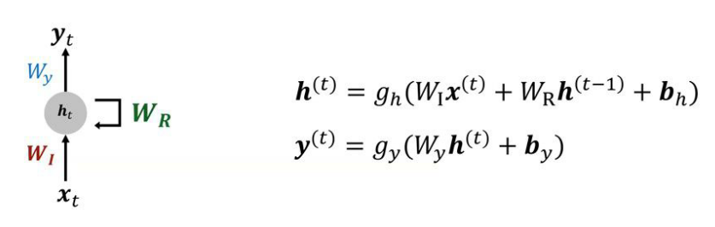
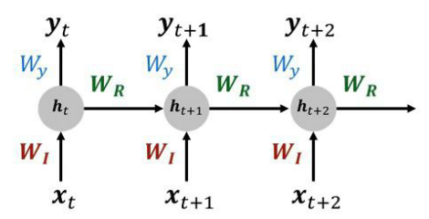
Recurrent Neural Network
Recurrent Feedback
Consider Past / Memory /Dependency
Unfold RNN

Slide 4
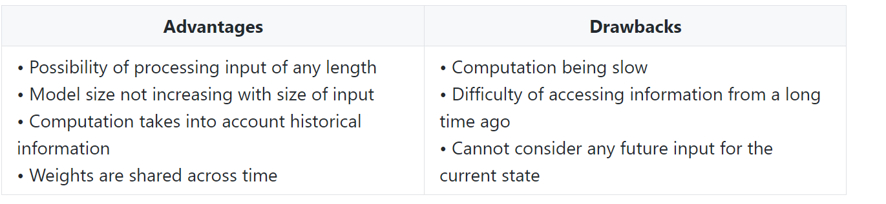
Recurrent Neural Network
Source: https://stanford.edu/~shervine/teaching/cs-230/cheatsheet-recurrent-neural-networks#architecture

Slide 5
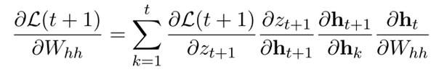
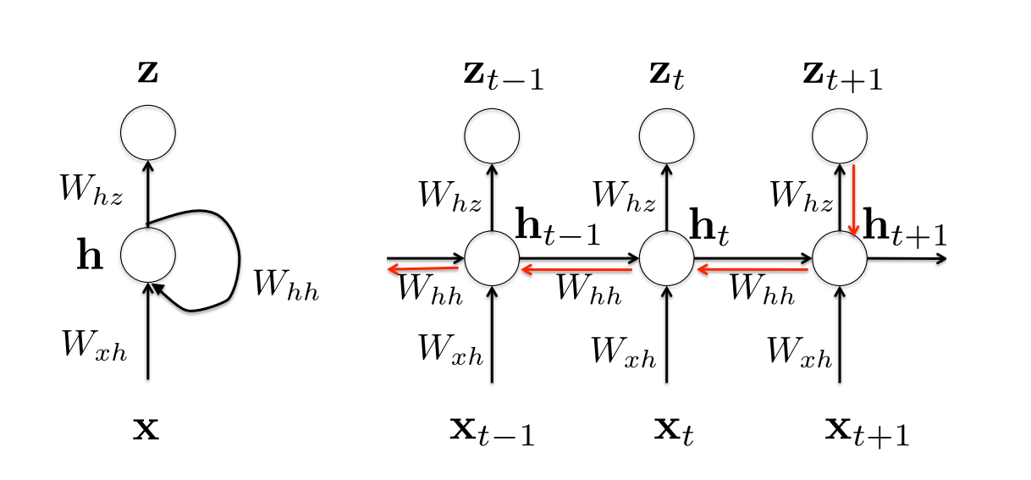
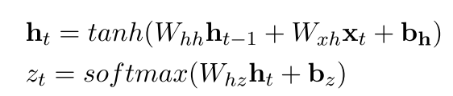

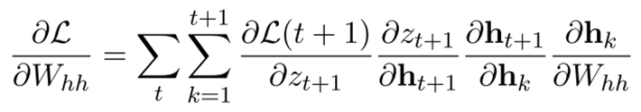

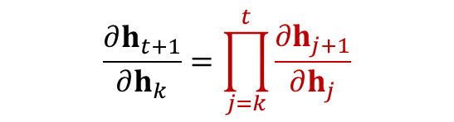
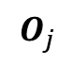
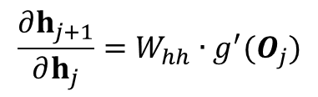
RNN – Error Gradient
$$O_{j}$$
$$\frac{∂h_{t+1}}{∂h_{k}}=\prod_{j=k}^{t}{\frac{∂h_{j+1}}{∂h_{j}}}$$
$$\frac{∂h_{j+1}}{∂h_{j}}=W_{hh}{ ∙g}^{′}(O_{j})$$

Slide 6
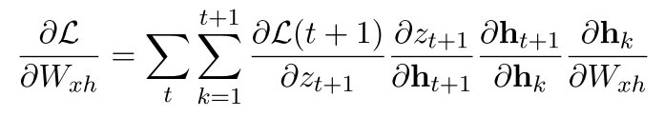
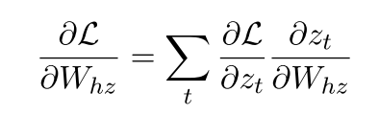
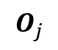
RNN – Error Gradient
$$O_{j}$$
$$\frac{∂h_{t+1}}{∂h_{k}}=\prod_{j=k}^{t}{\frac{∂h_{j+1}}{∂h_{j}}}$$
$$\frac{∂h_{j+1}}{∂h_{j}}=W_{hh}{ ∙g}^{′}(O_{j})$$

Slide 7
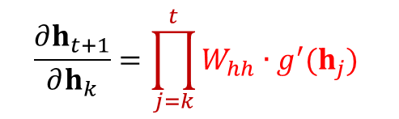
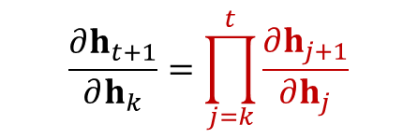
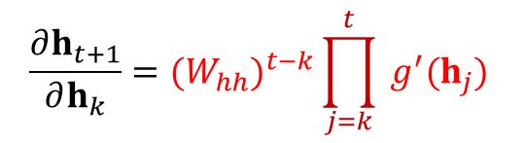
RNN – vanishing or exploding gradient
Error gradient computation involve chain of multiplication of same weights and gradient of activation function
It involve power of weight that likely to vanish or explode
It may lead to vanishing or exploding gradient
This term likely to vanish or explode
$$\frac{∂h_{t+1}}{∂h_{k}}=\prod_{j=k}^{t}{\frac{∂h_{j+1}}{∂h_{j}}}$$
$$\frac{∂h_{t+1}}{∂h_{k}}=\prod_{j=k}^{t}{W_{hh}{ ∙g}^{′}(h_{j}) }$$
$$\frac{∂h_{t+1}}{∂h_{k}}={{(W}_{hh})}_{}^{t−k}\prod_{j=k}^{t}{{ g}^{′}(h_{j}) }$$
Remedy to it is Long Short Term Memory (LSTM) RNN architecture

Slide 8
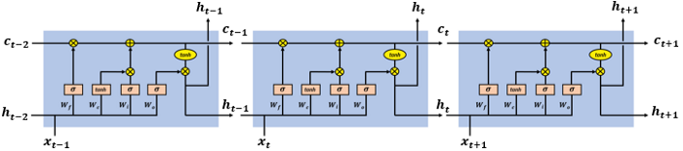
LSTM
Memory state or path or cell …
Long-Short Term Memory (LSTM)
Recurrent Feedback II
(Like skip connection!!!)
LSTM Cell
LSTM Cell
LSTM Cell
Recurrent Feedback I
(Like standard RNN !)

Slide 9
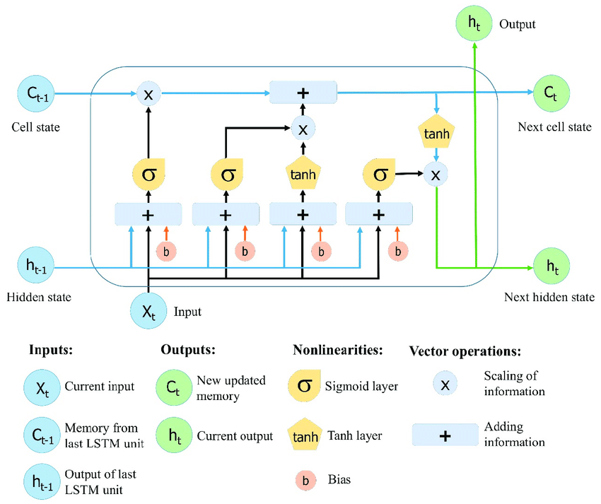
LSTM Cell
Cell State analogues to memory which can be created, updated and deleted or forgetted and retrieved
Forget gate
(memory update or deletion ? )
Output Gate
(Memory retrieval ? )
Input gate
(memory update? )

Slide 10
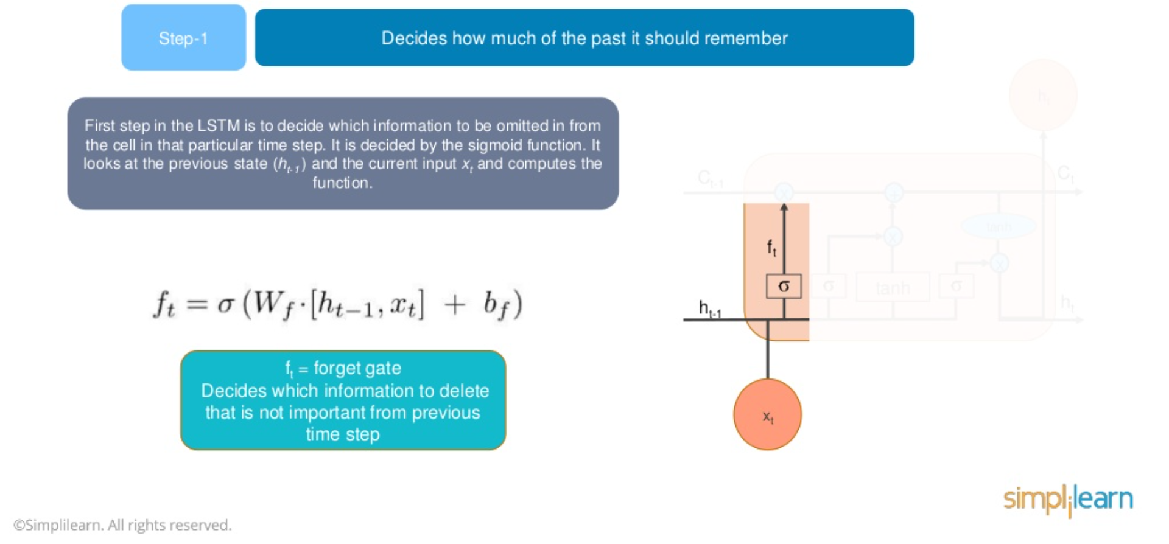
LSTM Cell – forget gate

Slide 11
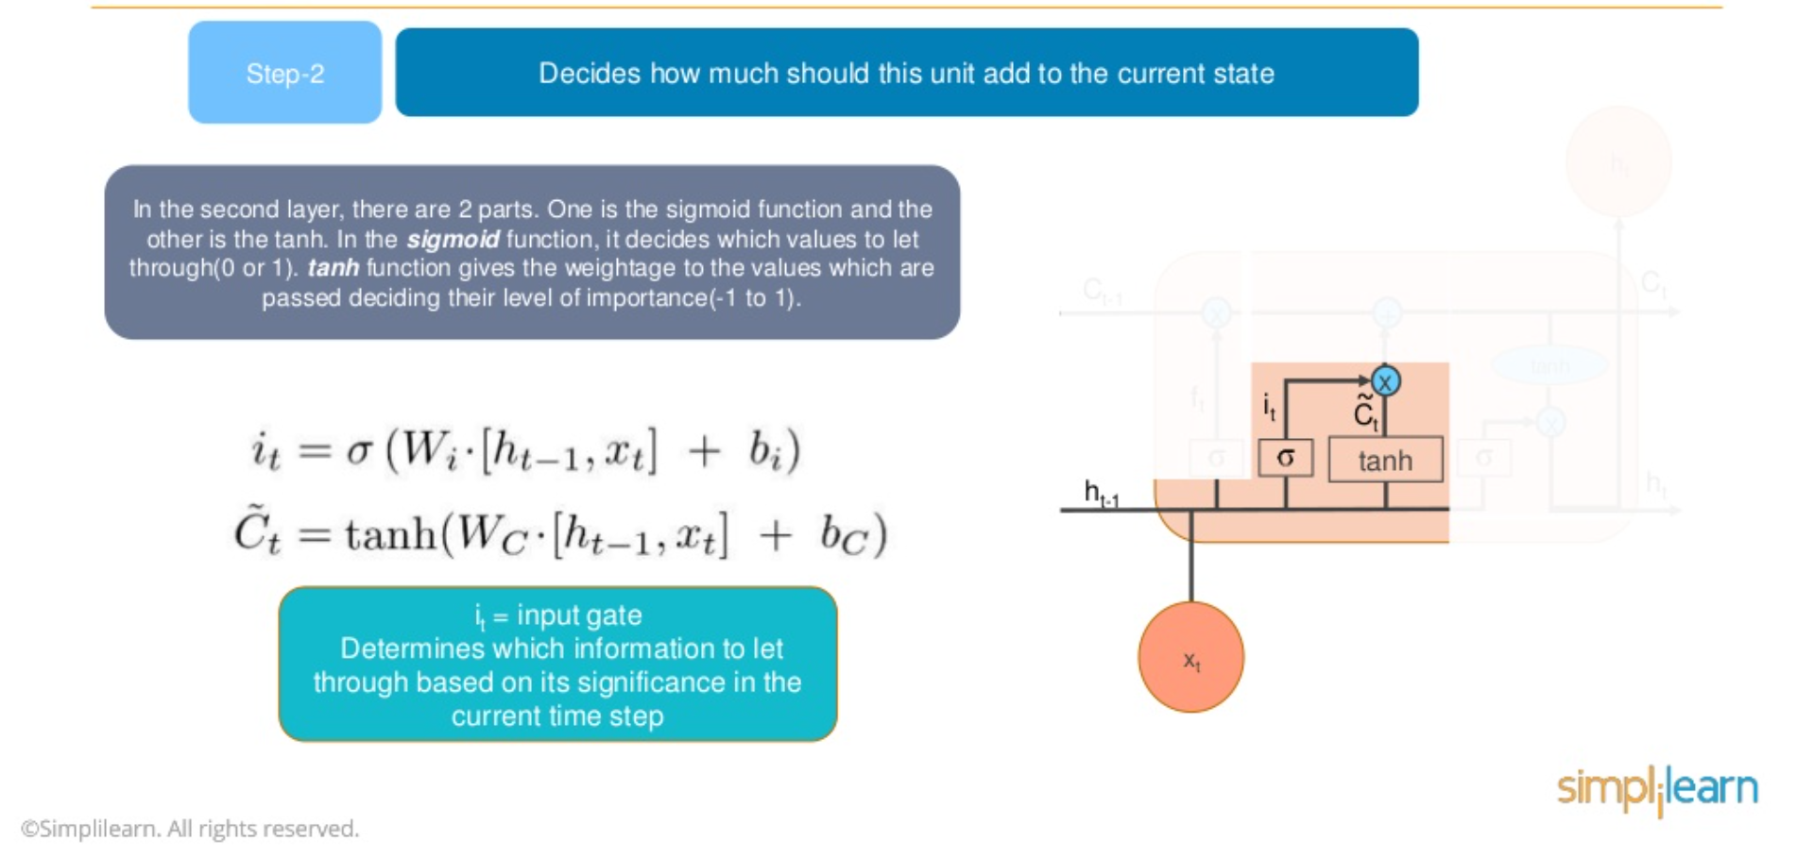
LSTM Cell – input gate

Slide 12
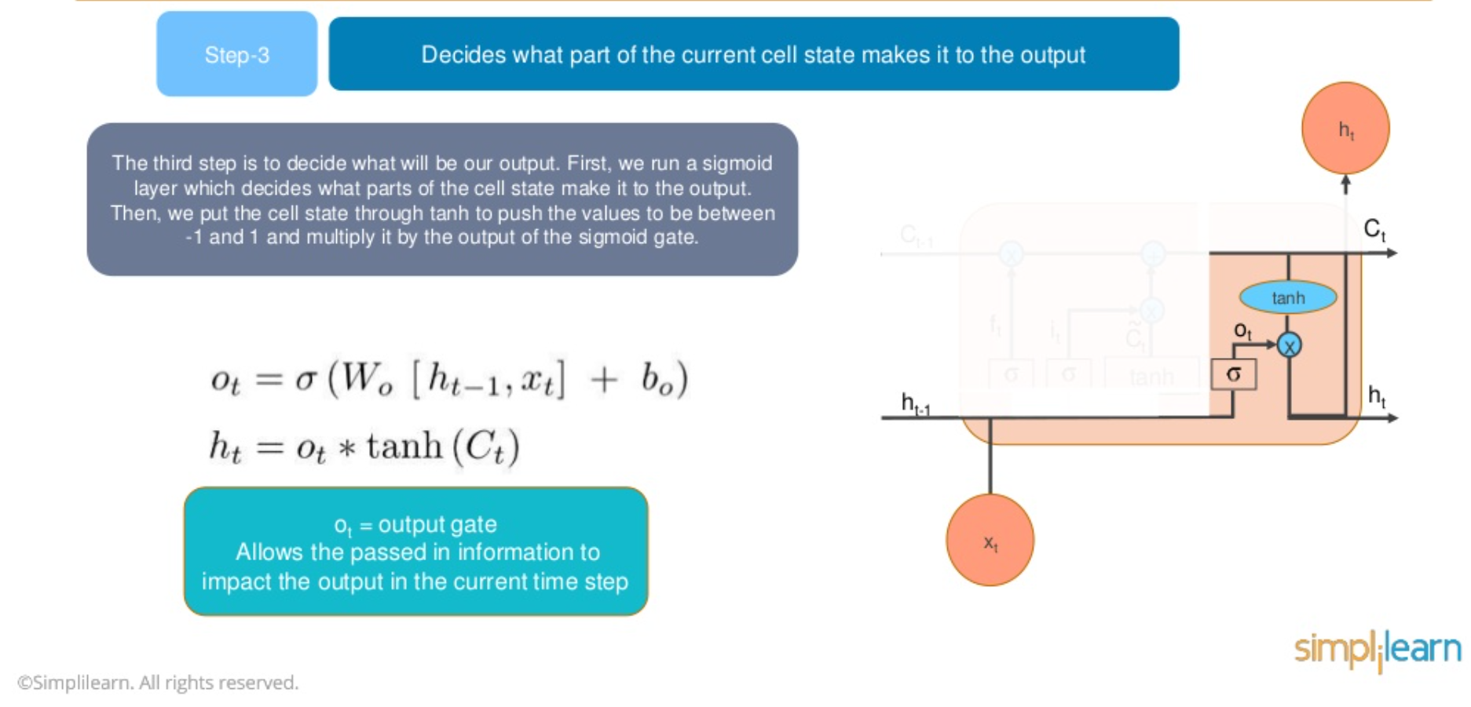
LSTM Cell – output gate

Slide 13
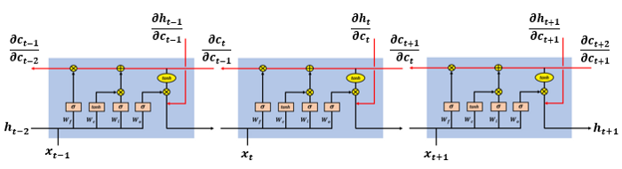
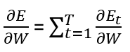
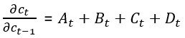
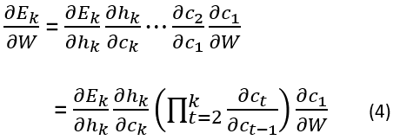
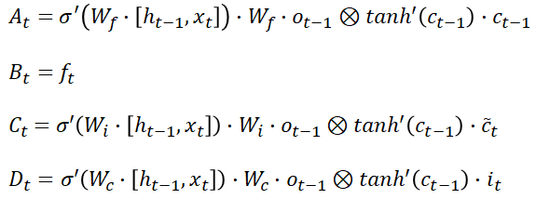
LSTM – Error Gradient

Slide 14
LSTM – Error Gradient
Gradient depends on multiple terms
B_{t} (forget gate) less likely to allow gradient to vanish
Overall, vanish/exploding gradient happen less likely in LSTM RNN compared to standard RNN

Slide 15
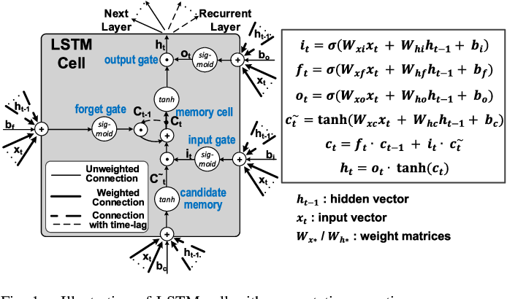
LSTM
another representation
Vectors…

Slide 16
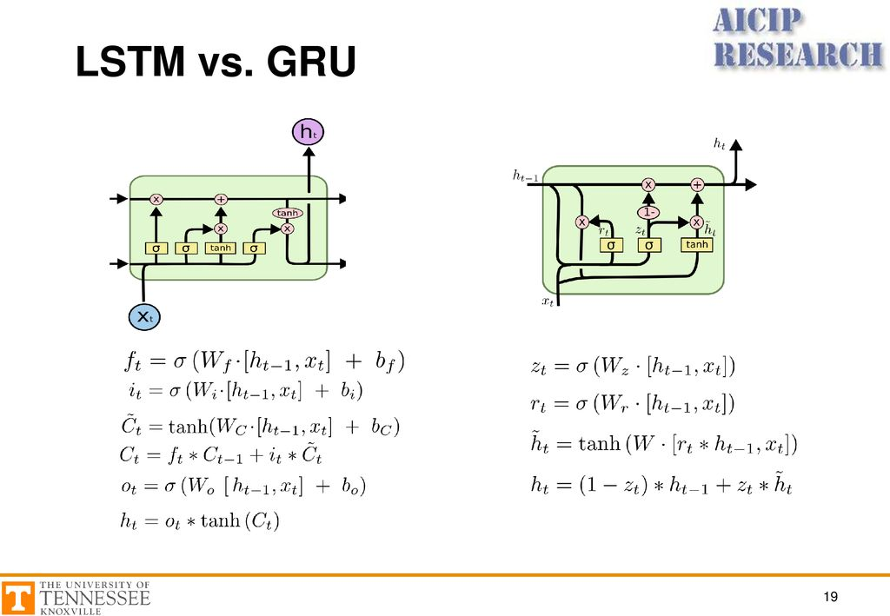
GRU – Gated Recurrent Unit
Simple form of LSTM
Only one path that is cell state,
May not capture long-term dependency ?
Performance for LSTM and GRU is comparable and application dependant
X

Slide 17
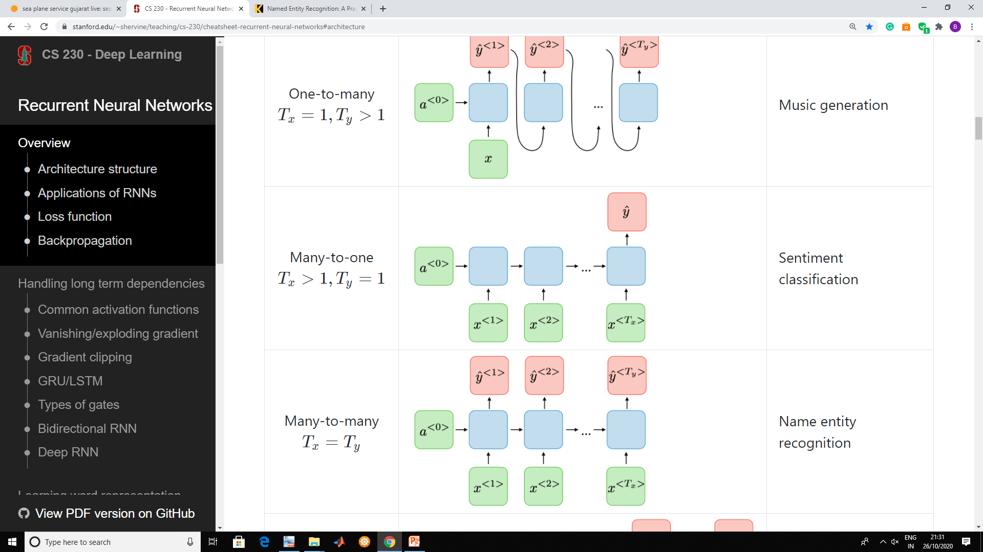
RNN Architectures
Many to Many
Sequence prediction
Auto regression
Machine translation

Slide 18
RNN Architectures
Many to One
Sequence Classification
Auto-regression

Slide 19
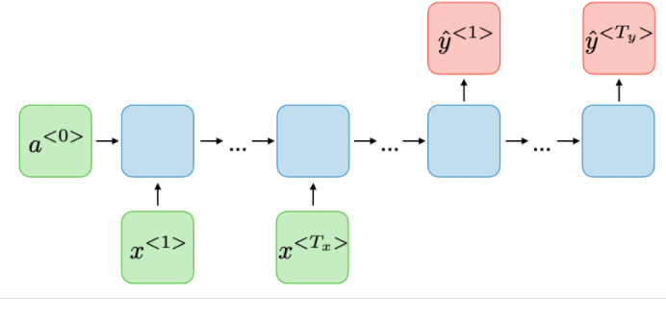
RNN Architectures
Many to Many
Sequence prediction
Auto regression

Slide 20
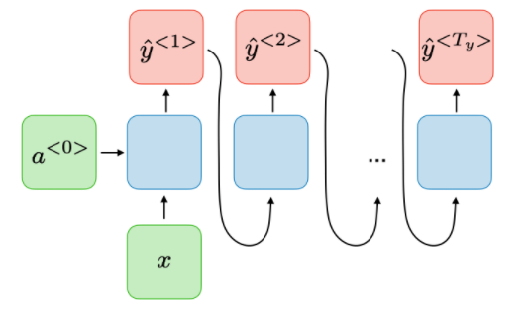
RNN Architectures
One to Many
Image captioning
Music generation

Slide 21
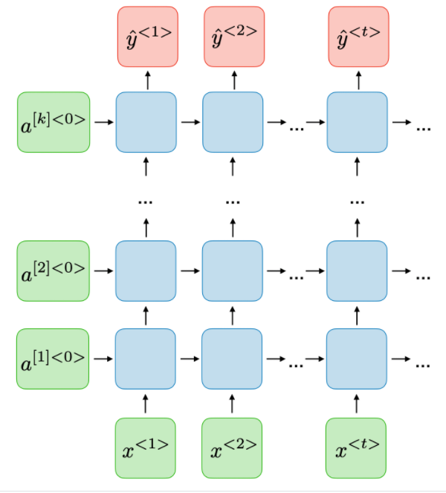
RNN Architectures
Deep RNN

Slide 22

RNN Architectures
Bidirectional RNN
Capture both Forward and Backword dependency

Slide 23
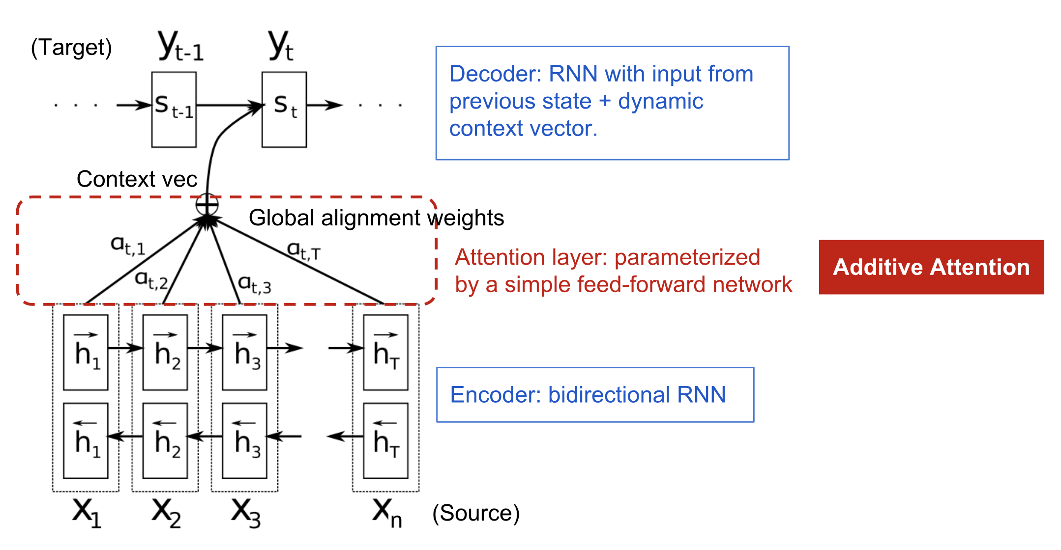
RNN with Attention

Slide 24
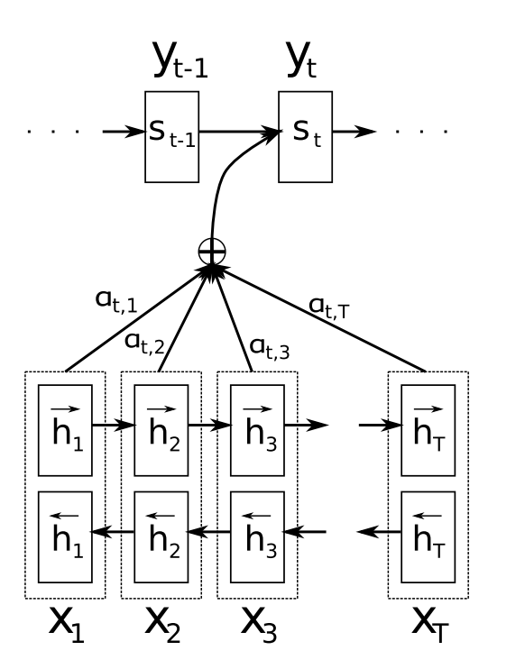
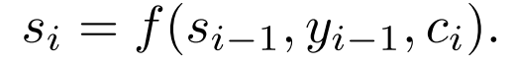
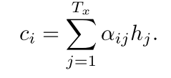
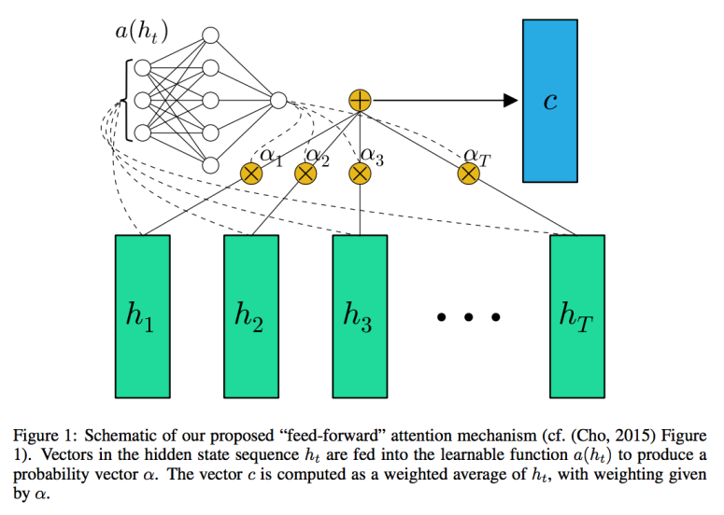
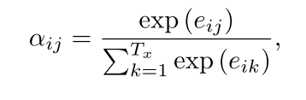
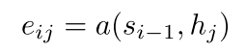
RNN with Attention
Output from RNN
Input to RNN
Context Vector
Weighted contribution from each time event
Softmax weighting
(attention/probability/weightage to input e.g. time event)
Neural Network
Source : https://miro.medium.com/max/2204/1*ABkaR2glZNP6oh08oY4l-Q.png

Slide 25
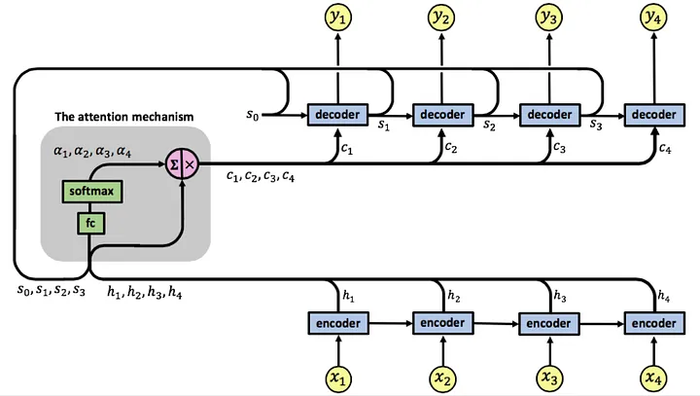

Slide 26
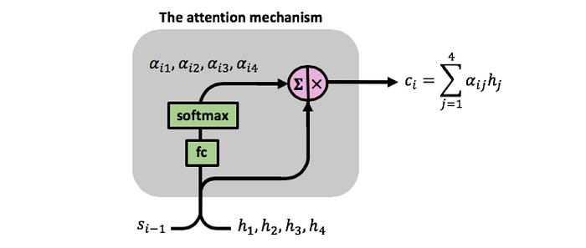
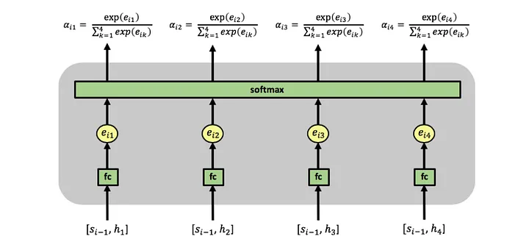

Slide 27
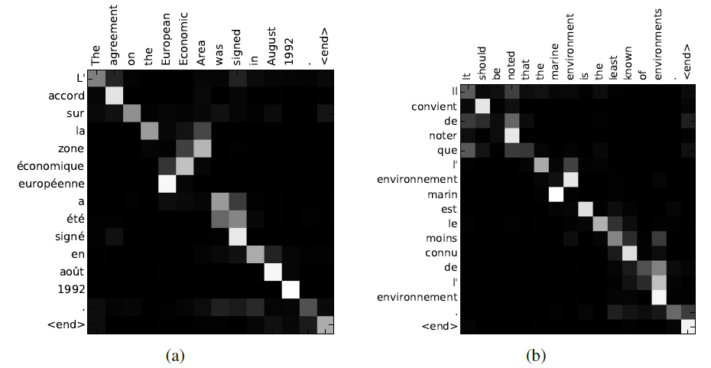
RNN with Attention
Example, Machine Translation
Bahdanau et al, “Neural Machine Translation by Jointly Learning to Align and Translate”, ICLR 2015

